Slide 1


M.Tech Program
Advanced Industry Integrated Programs
Jointly offered by University and LTIMindTree
Project Title: AI-Based Interior Design & Renovation Cost Estimator
ANMOL CHAUBEY - 24MAI0111
Knowledge partner | Implementation partner

Slide 2
Project Title - Calibri body 18
Introduction
Interior renovation and cost estimation is a critical process for homeowners, interior designers, and contractors. However, the traditional approach is often slow, manual, and lacks transparency. Existing tools are either limited to specific calculations like paint or flooring, or they only provide visualization without real cost breakdowns. Contractors, on the other hand, often take time and give subjective estimates, making decision-making difficult. This project aims to overcome these challenges by developing an AI-driven cost estimator that delivers fast, accurate, and customizable results.

Slide 3
Project Title - Calibri body 18
Introduction
Traditional cost estimation is manual, slow, and non-transparent.
Current calculators (paint/flooring) are too narrow in functionality.
AR tools (IKEA/Houzz) focus only on visualization, not costs.
Contractor estimates are delayed and inconsistent.
Need for an AI-based cost estimation tool that is fast, accurate, and customizable.

Slide 4
Project Title - Calibri body 18
Objective
The objective of this project is to build an AI-based system that analyzes room images, detects items and features, and calculates required materials with costs. It combines image analysis, material estimation, and region-specific pricing to provide fast, accurate, and transparent renovation cost estimates, with flexibility for different budget levels.

Slide 5
Project Title - Calibri body 18
Scope
The scope of this project extends from taking user inputs such as room images, size, material preferences, and location, to generating a complete cost estimation report. It not only provides the estimated cost range but also offers a detailed breakdown of materials, labor, and other requirements. The system is designed to cater to individual homeowners, interior designers, contractors, and real estate developers. In future, it can be extended to full house cost estimation and integrated with AR visualization for better decision-making.

Slide 6
Project Title - Calibri body 18
Scope
Inputs: Room image, size/dimensions, material preferences, location.
Outputs: Estimated cost range with detailed cost breakdown.
Stakeholders: Homeowners, interior designers, contractors, real estate developers.
Coverage: Paint, flooring, ceiling, furniture, lighting, and labor.
Customization: Budget, premium, and luxury options.
Future Scope: Full house estimation, AR/3D visualization, integration with e-marketplaces.

Slide 7
Project Title - Calibri body 18
Literature Review
Several tools and approaches currently exist for estimating renovation or interior costs, but each has limitations. Paint and flooring calculators are simple but restricted to single-material calculations. Augmented Reality (AR) tools like IKEA and Houzz focus mainly on visualization and product placement, not complete cost estimation. Manual contractor-based methods provide full estimates, but they are time-consuming, inconsistent, and often lack transparency. A gap exists for an integrated, AI-driven solution that combines automation, transparency, and regional adaptability.

Slide 8
Project Title - Calibri body 18
Literature Review
Paint/Flooring Calculators → Limited to single-material (paint liters, tile sq.ft).
IKEA/Houzz AR Tools → Focus on visualization, not labor/material costing.
Manual Contractor Estimates → Time-consuming, inconsistent, and subjective.
Lack of Integration → No single system combines AI detection, material costing, and regional adaptability.

Slide 9
Project Title - Calibri body 18
Summary of Literature
Calculators: Fast but limited to single material (narrow scope).
AR Tools: Good for visualization but lack cost estimation.
Contractor Estimates: Cover all aspects but are slow and inconsistent.
Gap Identified: No tool integrates AI detection + cost breakdown + regional pricing.
Opportunity: Develop a first-of-its-kind solution that is fast, transparent, and adaptable.

Slide 10
Project Title - Calibri body 18
Additional Information: Proposed System Flow
The system takes user inputs like room images and dimensions, processes them with AI to detect features and calculate material needs, and maps this with regional cost data. Finally, it generates a transparent cost report with detailed breakdowns and recommendations.
Input: Room image, dimensions, preferences, location.
Processing: AI detection → material calculation → cost mapping.
Output: Estimated cost range, detailed breakdown, suggestions.

Slide 11
Project Title - Calibri body 18
Additional Information: Benefits
The system brings speed, accuracy, and transparency to renovation cost estimation. It helps users save time, avoid inconsistent manual estimates, and make informed decisions with region-specific data.
Saves time with instant estimates.
Provides transparent & standardized pricing.
Customizable for budget, premium, luxury options.
Scalable for homeowners, designers, contractors, developers.

Slide 12
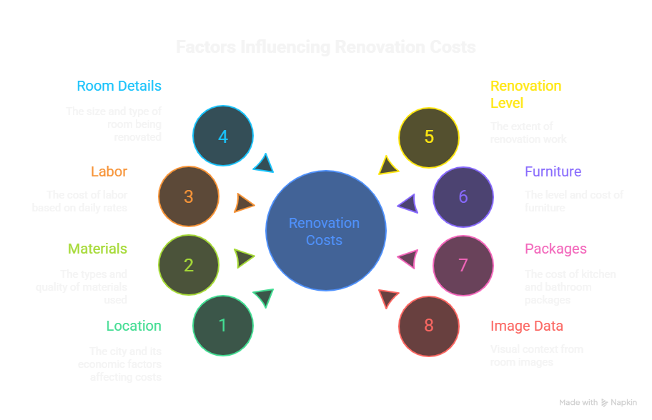
Project Title - Calibri body 18
Additional Information: Dataset Sample

Slide 13
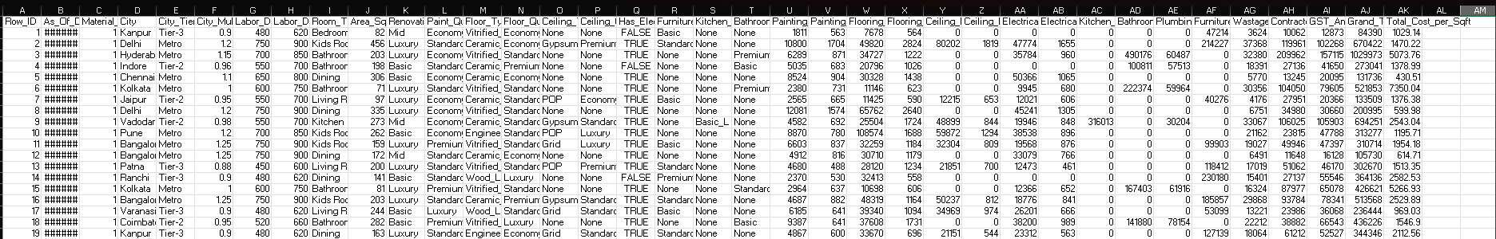
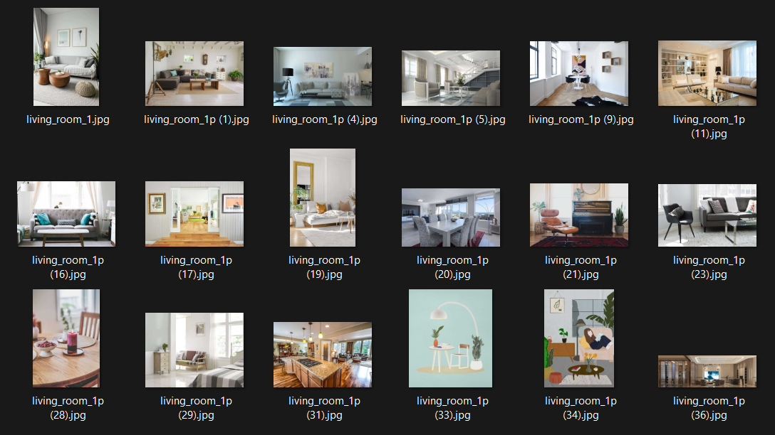
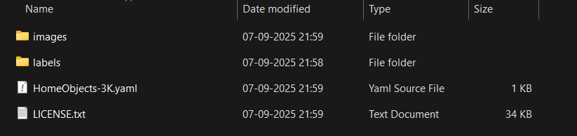
Project Title - Calibri body 18
Additional Information: Dataset Sample
Tabular Dataset:
Image Dataset:

Slide 14
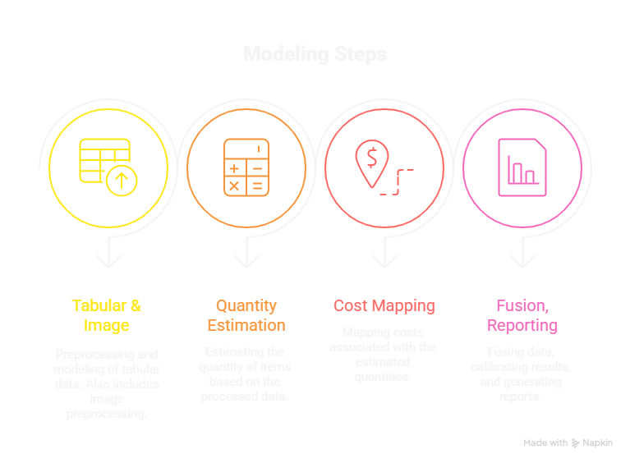
Project Title - Calibri body 18
Modules to cover:
M1: Tabular & Image Preprocessing/Modeling
M2: Quantity Estimation (from dimensions & detections)
M3: Cost Mapping (city, labor, material indices)
M4: Fusion, Calibration & Reporting

Slide 15
Project Title - Calibri body 18
Module 1: Tabular & Image Preprocessing/Modeling
This module handles preparing both the tabular dataset and the room images so they can be used effectively in later stages.
Clean and preprocess tabular features (encode, scale, handle missing values).
Preprocess images (resize, normalize, augment if needed).
Train/obtain embeddings or detections to represent image features.

Slide 16
Project Title - Calibri body 18
Module 2: Quantity Estimation
This module converts room dimensions and detected features into actual material requirements.
Calculate paint liters, flooring tiles, ceiling area, and furniture requirements.
Use image detections + dimensions to refine estimates.
Add wastage factors and prepare structured material quantity outputs.

Slide 17
Project Title - Calibri body 18
Module 3: Cost Mapping
This module maps material quantities to real-world cost data specific to location and labor.
Map quantities to unit costs using city multipliers and material price index.
Include labor charges, overheads, and taxes.
Generate a detailed category-wise cost breakdown (painting, flooring, ceiling, etc.).

Slide 18
Project Title - Calibri body 18
Module 4: Fusion, Calibration & Reporting
This module combines all features, predicts the final renovation cost, and generates user-friendly reports.
Fuse tabular + image features into the final prediction model.
Calibrate outputs to give reliable cost ranges (min–max).
Generate reports with total estimate and detailed breakdown.

Slide 19
Project Title - Calibri body 18
THANK YOU

